Slide 1
PDF Question Answering (RAG + Chatbot)
Project Overview & Reflection

Slide 2
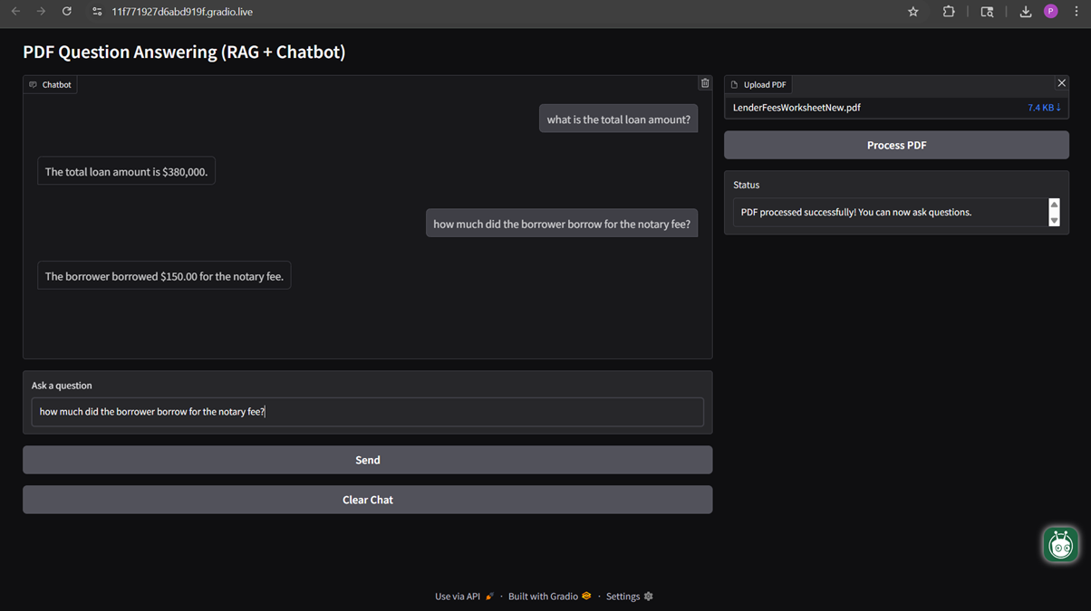
Screenshot UI action

Slide 3
System Architecture (RAG Pipeline)
• PDF text extraction using PyMuPDF
• Text chunking & embeddings (OpenAI + FAISS)
• Vector search for retrieval
• GPT-based answer generation
• Gradio UI for interactive Q&A

Slide 4
Reflection: What I Added or Changed
• Built a cleaner UI using Gradio Blocks
• Improved text chunking for more accurate retrieval
• Integrated FAISS for fast vector search
• Added multi-turn chatbot conversation history
• Enhanced prompts for context-aware answering

